Slide 1
Thermo chemistry Chapter 6
Dr. sultana bedoura

Slide 2
Lecture Plan
Energy
Energy change in chemical reaction
Exothermic and endothermic processes
The first law of thermodynamics
Work, heat and internal energy
Enthalpy
Thermochemical equation
Calorimeter
Hess’s Law
Enthalpy of solution

Slide 3
Energy
Energy is the capacity to do work
Radiant energy : comes from the sun and is earth’s primary energy source
Thermal energy : associated with the random motion of atoms and molecules
Chemical energy: the energy stored within the bonds of chemical substances
Nuclear energy : the energy stored within the collection of neutrons and protons in the atom
Potential energy : the energy available by virtue of an object’s position
Law of conservation of energy
“The total quantity of energy in the universe is assumed constant”

Slide 4
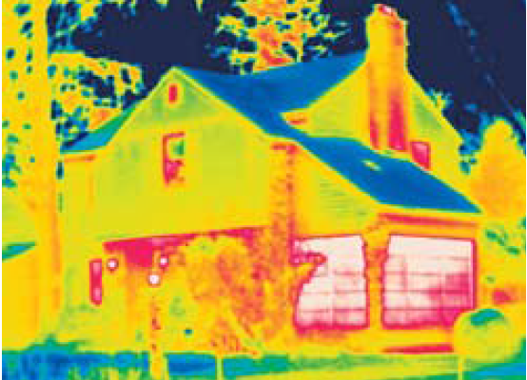
Heat and Thermochemistry
Almost all chemical reactions absorb or produce (release) energy, generally in the form of heat
Heat is the transfer of thermal energy between two bodies that are at different temperatures
Temperature is a measure of the thermal energy
Thermochemistry is the study of heat change
in chemical reactions
When heat is absorbed or released during a process,
energy is conserved, but it is transferred between
system and surroundings
This infrared photo shows where energy (heat) leaks through the house. The more red the color, the more energy is lost to the outside

Slide 5
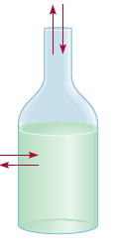
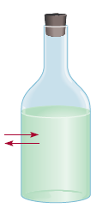

The Systems and Surroundings
The system is the specific part of the universe that is of interest in the study
The surroundings are the rest of the universe outside the system
Three types of systems:
Water vapor
Heat
Heat
Open system
Allows the exchange of
both energy and mass
with surroundings
Closed system
Allows the exchange of
energy but not mass
Isolated system
Allows neither
energy nor mass
To be exchanged

Slide 6
Exothermic and Endothermic Processes
Exothermic process : The process that gives off heat – transfers thermal energy from the system to the surroundings of interest in the study
Endothermic process : The process in which heat has to be supplied to the system from the surroundings
2H₂ (g) + O₂ (g) 2H₂O (l) + energy
H₂O (g) H₂O (l) + energy
energy + 2HgO (s) 2Hg (l) + O₂ (g)
energy + H₂O (s) H₂O (l)
Exothermic : Heat released, System surroundings
Endothermic: Heat absorbed, System surroundings

Slide 7
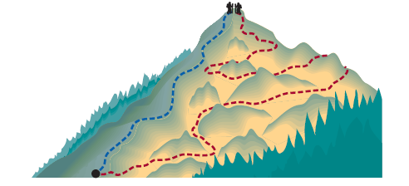
Thermodynamics
Thermodynamic: The scientific study of the interconversion of heat and other kinds of energy
State functions : Properties that are determined by the state of the system, regardless of how that condition was achieved.
E.g. energy, pressure, volume, temperature
∆E = E_{final} – E_{initial}
∆P = P_{final} – P_{initial}
∆V = V_{final} – V _{initial}
∆T = T_{final} – T_{initial}
Paths (Blue and red) are different though the potential energy of two hikers is same

Slide 8
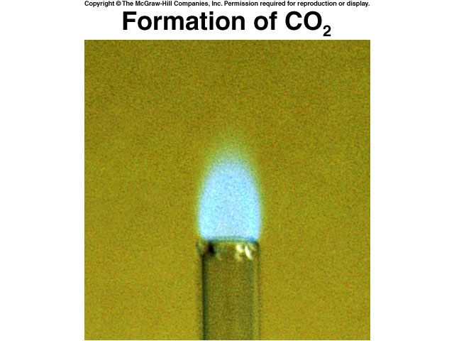
First Law of Thermodynamics
Energy can be converted from one form to another, but cannot be created or destroyed
∆E_{system} + ∆E_{surroundings} = 0
∆E_{system} = - ∆E_{surroundings}
C₃H₆ + 5O₂ 3CO₂ + 4H₂O + energy
Chemical energy lost by combustion = energy gained by the surroundings

Slide 9
First Law of Thermodynamics
Another form of first law of thermodynamics, ∆E = q + w
∆E is the change in internal energy of a system, a state function
q is the heat exchange between the system and the surroundings
w is the work done on (or by) the system
Table: Sign Conventions for Work and Heat
w = -P∆V , when a gas expands against a constant external pressure
Process | In brief | Sign
Work done by the system on surroundings | System works | ─
Work done on the system by surroundings | Surroundings work | +
Heat absorbed by the system from the surroundings | Endothermic process | +
Heat absorbed by the surroundings from the system | Exothermic process | ─

Slide 10
Work (w) and Heat (q)
Work and Heat
Work |  | Heat
Work (w) = force (f) x distance (d) |  | Heat is kind of energy, q = ∆E – w
Work done by gas on the surrounding is, w = - P ∆V |  | Describes about the process Temperature is the measure of heat
-P ∆V =(F/ d² )x d³ = F x d = W |  | Temperature and heat is not same
Not a state function w = w_{final} – w _{initial} |  | Not a state function q = q _{final} – q _{initial}
Unit : joules (J) |  | Unit: joules (J)
∆V > 0; -P ∆V < 0; w_{sys} < 0

Slide 11
Class work
The work done when a gas is compressed in a cylinder is 462 J. During this process, there is a heat transfer of 128 J from the gas to the surroundings. Calculate the energy change for this process.
∆E = q + w
= -128 J + 462 J
= 334 J

Slide 12
Class work
A gas expands and does P - V work on the surroundings equal to 325 J. At the same time, it absorbs 127 J of heat from the surroundings. Calculate the change in energy of the gas.
∆E = q + w
= 127 J - 325 J
= -198 J

Slide 13
Class work
A sample of nitrogen gas expands in volume from 1.6 L to 5.4 L at constant temperature. What is the work done in joules if the gas expands (a) against a vacuum and (b) against a constant pressure of 3.7 atm?
∆V = 5.4 L – 1.6 L = 3.8 L
(a) Given , P = 0
∴w = - P∆V = 0 x 3.8 = 0 j
(b) Given , P = 3.7 atm
∴w = - P∆V
101.325 X 10³ Pa 1 m³
= -3.7 atm x x 3.8 L x
1 atm 10³ L
= -1424.6 Pa.m³ = - 1424.6 j

Slide 14
Internal Energy and the First Law of TD
How first law of TD can be applied to processes carried out under different conditions
Two situations most commonly encountered in the laboratories:
Pressure on the system kept constant:
∆E = q - P ∆V
Volume of the system kept constant: ∆E = q + w = q_{v} − P ∆V = q_{v} [∆V = 0 ]
When the process is so rapid :
Assume no heat exchange occurs between the system and its surroundings;
∆E = q + w = 0 ± w [q = 0]

Slide 15
Enthalpy
Enthalpy (H): The amount of heat content used or released in a system at constant pressure.
Expressed as the change in enthalpy. (ΔH)
ΔH = H (products) – H (reactants)
Heat used/consumed: endothermic: ΔH> 0
Heat released/ produced: exothermic: ΔH<0
Unit(SI): Joules/ Calorie [1 cal = 4.184 J]
ΔH is a state function

Slide 16
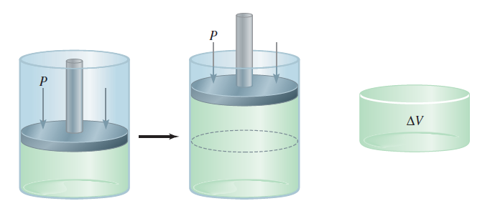
Enthalpy & the First Law of TD
First Law of Thermodynamics: E = q + w
At constant pressure:
ΔE = q_{P} – PΔV
∴q_{P} = ΔE + PΔV….. (1)
For Enthalpy (H) a new function:
H = E + PV
ΔH = ΔE + Δ (PV) @ constant P
ΔH = ΔE + PΔV….. (2)
From (1) & (2) ⇒ ΔH = q_{P}
Enthalpy : quantify the heat flow into or out of a system that occurs at constant pressure
ΔH is a state function. Whereas q_{p} is not state function

Slide 17
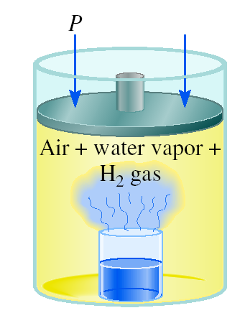
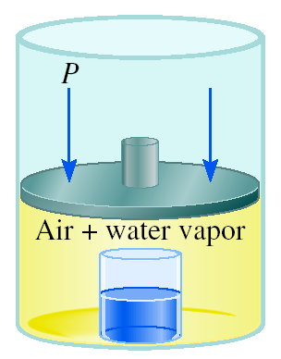
A Comparison of ∆H and ∆ E
2Na(s) + 2H₂O(l) 2NaOH (aq) + H₂(g) ΔH = -367.5 kJ/mol
Assumption: T = 25⁰C and ΔV is negligible
Then, @ 1 atm and 25 ºC, 1 mole H₂ = 24.5 L
-PΔV = -1 atm x 24.5 L = -2.5 kJ
Δ E = Δ H - PΔV = -367.5 kJ/mol – 2.5 kJ/mol = -370.0 kJ/mol
ΔH and ΔE are approximately same.
In above reaction, the ΔH is smaller than ΔE
as some internal energy released to do gas expansion work.
For reactions that do not involve gases, ΔH = ΔE.
For ideal gases,
ΔE = ΔH – Δ(PV) = ΔH- Δ (nRT)
= ΔH- RT Δn [Δn = number of moles in product- number of moles in reactants]

Slide 18
Thermochemical Equations
In a chemical reaction two changes occur-
1. Chemical change
P₄(s) + 5O₂(g) → P₄O₁₀(s) ; ∆H = -3013 KJ/mol
2. Physical change
H₂O (s) → H₂O (l) ; ∆H = 6.01 KJ/mol
H₂O (l) → H₂O (g); ∆H = 6.01 KJ/mol

Slide 19
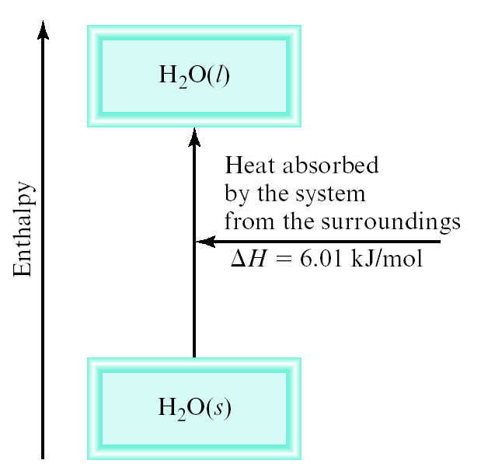
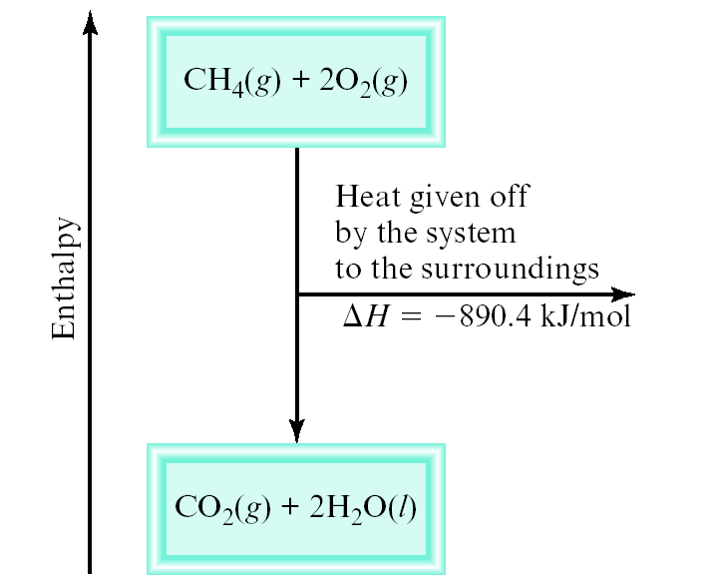
Thermochemical Equations
ΔH = heat given off or absorbed during a reaction at constant pressure
System absorbs heat
Endothermic
H_{products} > H_{reactants}
ΔH > 0
System gives off heat
Exothermic
H_{products} < H_{reactants}
ΔH < 0
6.01 kJ are absorbed for every 1 mole of ice that melts at 0⁰C and 1 atm
H₂O (s) H₂O (l) ΔH = 6.01 kJ/mol
890.4 kJ are released for every 1 mole of methane that is combusted at 25⁰C and 1 atm
CH₄ (g) + 2O₂ (g) → CO₂ (g) + 2H₂O (l) ; Δ H = -890.4 kJ/mol

Slide 20
Thermochemical Equations
The The stoichiometric coefficients always refer to the number of moles of a substance:
If you reverse a reaction, the sign of ΔH changes:
If you multiply both sides of the equation by a factor n, then ΔH must change by the same factor n:
The physical states of all reactants and products must be specified in thermochemical equations
H₂O (s) H₂O (l)
ΔH = 6.01 kJ/mol
H₂O (l) H₂O (s)
ΔH = -6.01 kJ/mol
2H₂O (s) 2H₂O (l)
ΔH = 2 x 6.01 = 12.0 kJ
H₂O (s) H₂O (l)
ΔH = 6.01 kJ/mol
H₂O (l) H₂O (g)
ΔH = 44.0 kJ/mol

Slide 21
Class Work
How much heat is evolved when 266 g of white phosphorus (P₄) burn in air?
P₄ (s) + 5O₂ (g) P₄O₁₀(s)
ΔH = - 3013 kJ/mol
1 mol P₄
-3013 kJ
266 g P₄
x
x
= -6470 kJ
123.9 g P₄
1 mol P₄

Slide 22
Specific Heat & Heat Capacity
The specific heat (s) of a substance: The amount of heat (s) required to raise the temperature of 1 gram of the substance by one degree Celsius.
unit: J/g . °C
Heat (q) absorbed or released: q = m x s x ∆t where , ∆t = t_{final} – t_{initial}
The heat capacity (C) of a substance: The amount of heat (q) required to raise the temperature of given quantity (m) of the substance by one degree Celsius. C = m x s
Unit: J/ °C
Heat (q) absorbed or released: q = C x ∆t where , ∆t = t_{final} – t_{initial}

Slide 23
Class Work
How much heat is given off when an 869 g iron bar cools from 94ºC to 5ºC?
s of Fe = 0.444 J/g • ºC
Δt = t_{final} – t_{initial} = 5ºC – 94ºC = –89ºC
q = ms Δ t
= 869 g x 0.444 J/g • ºC x –89ºC
= –34,000 J

Slide 24
Calorimetry
Calorimetry is the act of measuring the heat change of chemical reactions or physical changes
Calorimeter is the specifically designed closed container
We will discuss two different types of calorimeters-
Constant-volume calorimeter
Constant-pressure calorimeter

Slide 25
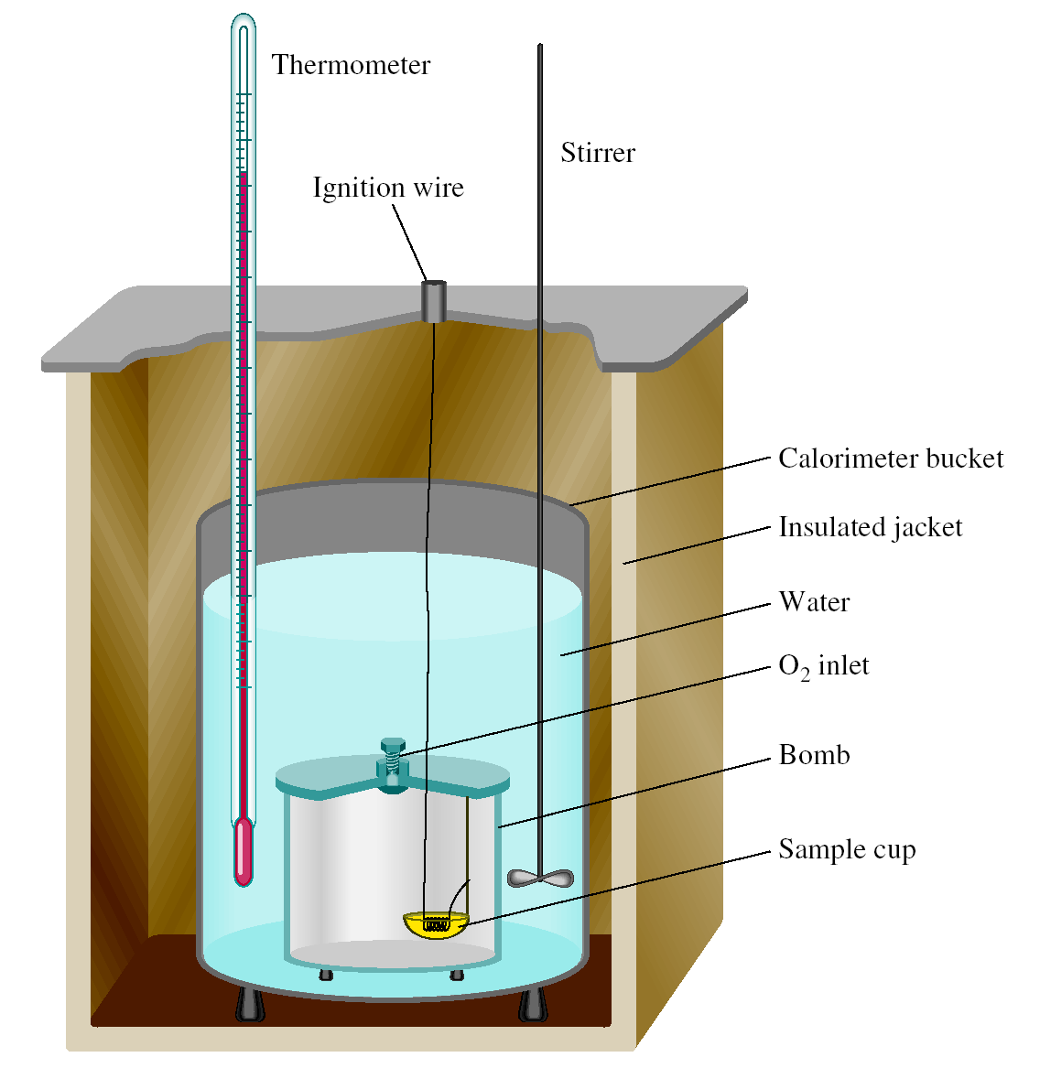
Constant-Pressure Calorimeter
q_{sys} = q_{water} + q_{bomb} + q_{rxn}
q_{sys} = 0
q_{rxn} = - (q_{water} + q_{bomb})
q_{water} = m x s x Δt
q_{bomb} = C_{bomb} x Δ t
Reaction at Constant V
Δ H = q_{rxn}
Δ H ~ q_{rxn}
No heat enters or leaves!

Slide 26
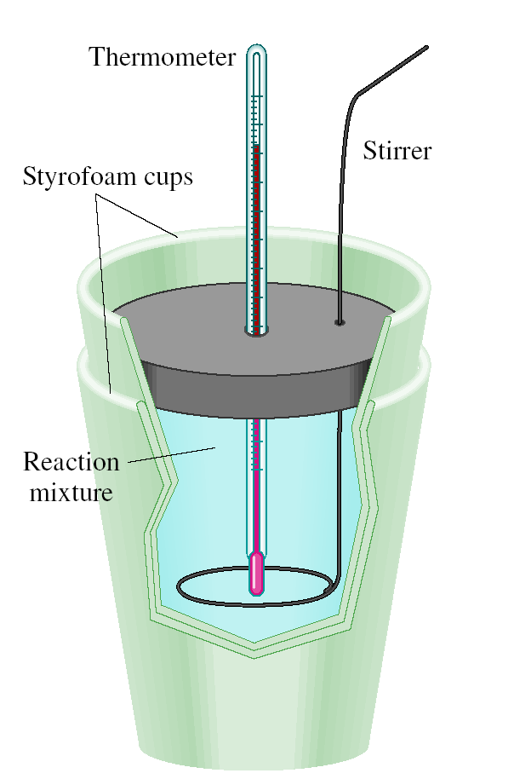
Constant-Volume Calorimeter
q_{sys} = q_{water} + q_{cal} + q_{rxn}
q_{sys} = 0
q_{rxn} = - (q_{water} + q_{cal})
q_{water} = m x s x Δt
q_{cal} = C_{cal} x Δt
Reaction at Constant P
ΔH = q_{rxn}
No heat enters or leaves!

Slide 27
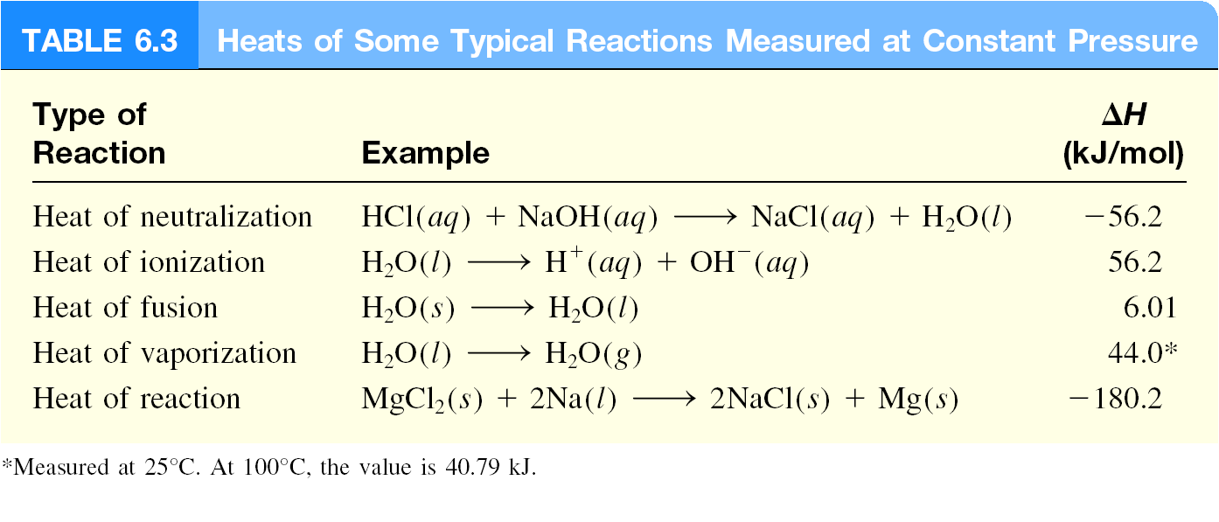
Heat of Typical Reaction at Constant P
Heats of some reactions measured at constant pressure

Slide 28
Standard Enthalpy of Formation
As there is no way to measure the absolute value of the enthalpy of a substance, must measure the enthalpy change for every reaction of interest
Establish an arbitrary scale with the standard enthalpy of formation (ΔH_{f}⁰) as a reference point for all enthalpy expressions
Standard enthalpy of formation (ΔH_{f}⁰) is the heat change that results when one mole of a compound is formed from its elements at a pressure of 1 atm
The standard enthalpy of formation of any element in its most stable form is zero
Standard enthalpy of reaction: For aA + bB → cC + dD
ΔH⁰ (O₂) = 0
Δ H⁰ (C, graphite) = 0
f
f
Δ H⁰ (O₃) = 142 kJ/mol
Δ H⁰ (C, diamond) = 1.90 kJ/mol
f
f
]
]
ΔH⁰
c ΔH⁰ (C)
d ΔH⁰ (D)
-
a ΔH⁰ (A)
+
b ΔH⁰ (B)
[
+
[
rxn
=
f
f
f
f

Slide 29
Hess’s law
When reactants are converted to products, the change in the enthalpy is same whether the reaction takes place in one step or in a series of steps.
Enthalpy is a state function, it does not matter how you got there, only where you start and end.
ΔH_{x}
A + B
C + D
ΔH₁
ΔH₂
Intermediate
Products
ΔH_{x} = ΔH₁ + ΔH₂

Slide 30
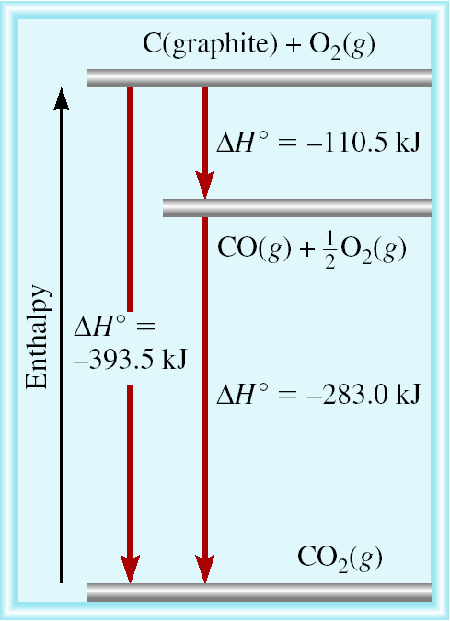
Standard Enthalpy of Formation
C(graphite) + O₂(g) CO₂(g)
CO(g) + 1/2O₂(g) CO₂(g)
C(graphite) + 1/2O₂(g) → CO(g) ?
C(graphite) + O₂(g) → CO₂(g)
+ CO₂(g) → CO(g) + 1/2O₂ (g)
C(graphite) + 1/2O₂(g) → CO(g)
ΔH⁰ (CO) = − 110.5 kJ/mol
f

Slide 31
Class Work
From these data, calculate the enthalpy change for the transformation
S(rhombic) → S(monoclinic)
S(rhombic) + O₂(g) → SO₂(g) ΔH°_{rxn} = -2296.06 kJ/mol
S(monoclinic) + O₂(g) → SO₂(g) ΔH°_{rxn} = -2296.36 kJ/mol
(Monoclinic and rhombic are different allotropic forms of elemental sulfur)
S(rhombic) + O₂(g) → SO₂(g) ΔH°_{rxn} = -2296.06 kJ/mol
SO₂(g) → S(monoclinic) + O₂(g) ΔH°_{rxn} = 2296.36 kJ/mol
S(rhombic) → S(monoclinic) ΔH°_{rxn} = 0.30 kJ/mol
(+)

Slide 32
Problem
Calculate the standard enthalpy of formation of CS₂ (l) given that:
C(graphite) + O₂ (g) CO₂ (g) ΔH⁰ = -393.5 kJ/mol
S(rhombic) + O₂ (g) SO₂ (g) ΔH⁰ = -296.1 kJ/mol
CS₂(l) + 3O₂ (g) CO₂ (g) + 2SO₂ (g) ΔH⁰ = -1072 kJ/mol
1. Write the formation reaction for CS₂
C(graphite) + 2S(rhombic) CS₂ (l)
rxn
rxn
rxn

Slide 33
Problem (cont^{d})
C(graphite) + 2S(rhombic) CS₂ (l)
2. Add the given rxns so that the result is the desired rxn.
C(graphite) + O₂ (g) CO₂ (g) ΔH⁰ = -393.5 kJ/mol
S(rhombic) + O₂ (g) SO₂ (g) ΔH⁰ = -296.1 kJ/mol
CO₂(g) + 2SO₂ (g) CS₂ (l) + 3O₂ (g) ΔH⁰ = +1072 kJ/mol
C(graphite) + 2S(rhombic) CS₂ (l)
ΔH⁰ = -393.5 + (2x-296.1) + 1072 = 86.3 kJ/mol
rxn
2
2
2
X 2
rxn
(+)
rxn
rxn

Slide 34
Problem
Benzene (C₆H₆) burns in air to produce carbon dioxide and liquid water. How much heat is released per mole of benzene combusted? The standard enthalpy of formation of benzene, water and CO₂ is 49.04 kJ/mol, -187.6 kJ/mol and -393.5 kJ/mol respectively.
2C₆H₆ (l) + 15O₂ (g) 12CO₂ (g) + 6H₂O (l)
ΔH⁰ _{rxn} = Σ nΔH_{f}⁰ (products) - Σ mΔH_{f}⁰ (reactants)
ΔH⁰ _{rxn} = [12 ΔH_{f}⁰ (CO₂) + 6 ΔH_{f}⁰ (H₂O)] – [ 2 ΔH_{f}⁰ (C₆H₆)]
ΔH⁰ _{rxn} = [12 x – 393.5 + 6 x -187.6] – [2 x 49.04] = - 5946 KJ
Heat released per mole of benzene = ( -5946 KJ) / 2 mol
= - 2973 KJ/mol C₆H₆

Slide 35
Problem
Calculate the standard enthalpy of formation of C₂H₂ from its elements:
2C(graphite) + H₂ (g) C₂H₂ (g)
The equations for each step and the corresponding enthalpy changes are
(a) C(graphite) + O₂(g) CO₂ (g) ΔH⁰ = -393.5 kJ/mol
(b) H₂(g) + 1/2O₂ (g) H₂O (l) ΔH⁰ = -285.8 kJ/mol
(c) 2C₂H₂(g) + 5O₂ (g) 4CO₂ (g) + 2H₂O (l) ΔH⁰ = -2598.8kJ/mol
ax4⇒ 4C(graphite) + 4O₂(g) 4CO₂ (g) ΔH⁰_{rxn} = 4 x -393.5 kJ/mol
cx-1⇒ 4CO₂ (g) + 2H₂O (l) 2C₂H₂(g) + 5O₂ (g) ΔH⁰_{rxn} =-1x -2598.8 kJ/mol
bx2⇒ 2 H₂(g) + O₂ (g) 2H₂O (l) ΔH⁰_{rxn} = 2x -285.8 kJ/mol
4C(graphite) + 2H₂ (g) 2 C₂H₂ (g) ΔH⁰_{rxn} = 453.2 kJ/mol
2C(graphite) + H₂ (g) C₂H₂ (g) ΔH⁰ = 226.6 kJ/mol
rxn
rxn
rxn
(+)
rxn

Slide 36
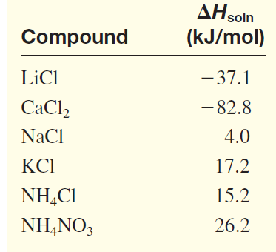
Enthalpy of Solution
The enthalpy of solution (Δ H_{soln}) is the heat generated or absorbed when a certain amount of solute dissolves in a certain amount of solvent.
Which substance(s) could be used for melting ice?
Which substance(s) could be used for a cold pack?
Given,
Heats of solution of some Ionic compounds
ΔH_{soln} = H_{soln} - H_{components}

Slide 37
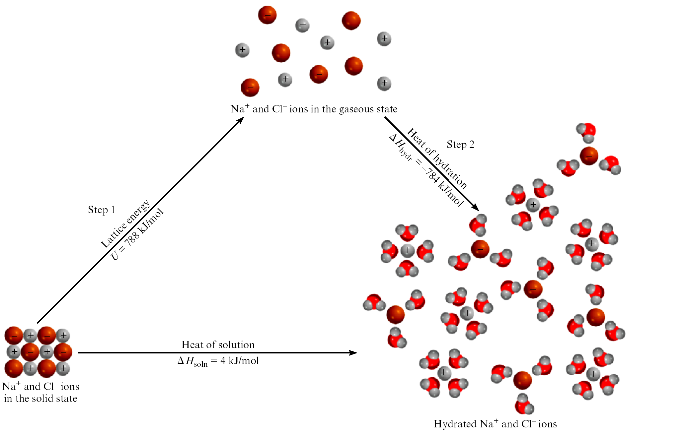
The Solution Process for NaCl
ΔH_{soln} = Step 1 + Step 2 = 788 – 784 = 4 kJ/mol

Slide 38
Thank You

